Slide 1
UIT2201 – Programming and Data Structures
Name Spaces

Slide 2
Name Space
A namespace is an abstraction that manages all the identifiers that are defined in a particular scope, mapping each name to its associated value.
In Python, functions, classes, and modules are all first-class objects, and so the “value” associated with an identifier in a namespace may in fact be a function, class, or module.

Slide 3
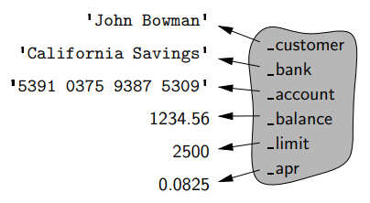
Instance Namespaces
The instance namespace, which manages attributes specific to an individual object. For example, each instance of our PredatoryCreditCard class maintains a distinct balance, a distinct account number, a distinct credit limit,
Instant namespace of PredatoryCreditCard

Slide 4
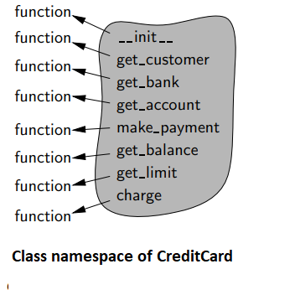
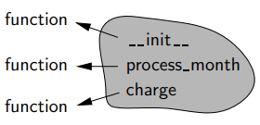
Class Namespaces
Class namespace for each class that has been defined. This namespace is used to manage members that are to be shared by all instances of a class, or used without reference to any particular instance.
Class namespace of PredatoryCreditCard

Slide 5
Name Resolution
Python interpreter begins a name resolution process, described as follows:
The instance namespace is searched; if the desired name is found, its associated value is used.
Otherwise, the class namespace, for the class to which the instance belongs, is searched; if the name is found, its associated value is used.
If the name was not found in the immediate class namespace, the search continues upward through the inheritance hierarchy, checking the class namespace for each ancestor (commonly by checking the superclass class, then its superclass class, and so on). The first time the name is found, its associate value is used.
If the name has still not been found, an AttributeError is raised.

Slide 6
Dynamic dispatch
Python uses what is known as dynamic dispatch (or dynamic binding) to determine, at run-time, which implementation of a function to call based upon the type of the object upon which it is invoked.
This is in contrast to some languages that use static dispatching, making a compile-time decision as to which version of a function to call, based upon the declared type of a variable

